Slide 1


Emmanuel Fasanya
University of North Texas
Graduating Class of December 2013
Rehab Director: Roel Ruiz
Supervising PT: Veronica Pagliwagan,PT
Director of Clinical Programs & University Affiliations: Kai Williams, PT, DPT

Slide 2
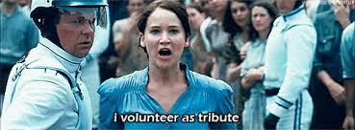
BRAVE VOLUNTEER????

Slide 3
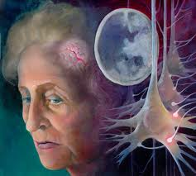
Cerebral
Vascular
Accident
Hypertonicity- Spastic state ex: Trieu Tran
Hypotonicity- Flaccid state ex: Dartanier
Expressive Aphasia-Language barriers

Slide 4

Different Strokes for Different Folks

Slide 5
Occupational Therapist
Address deficit to increase range of motion to be within functional limits
Utilize the use of compensatory strategies
Teach dressing techniques
Speech Language Pathologists
Address Dysphagia
Acknowledge slurred speech to possibly be apraxia or dysarthria- motor speech disorder
Work on articulation

Slide 6



Slide 7
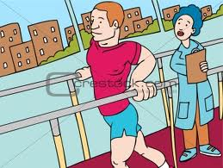
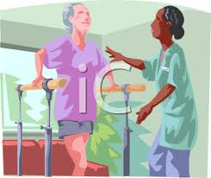
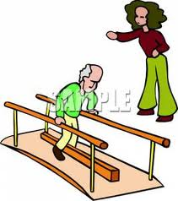
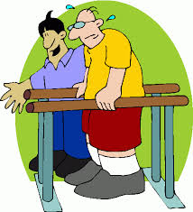
PHYSICAL THERAPY

Slide 8
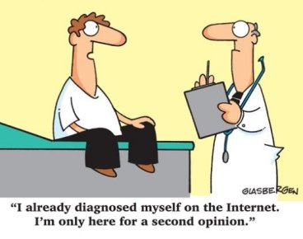
Physical Therapy
Medical history/chart
Do own homework by calling doctors and family
What goals are realistic for patient
Evaluation- test bed mobility/transfers/standing tolerance, etc.
See if walking is even possible

Slide 9
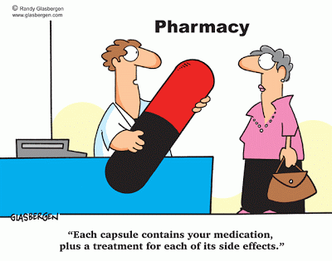
Physical Therapy
Medical Treatment
Paramedics will stabilize victim
Medication to break up the clot
Determine weather it is a thrombotic stroke or hemorrhagic
Know what side of the brain was affected
When treating a patient it is very important to take their medical issues into consideration
Know limits by continuing to have the patient communicate the way they are feeling
Take vitals
Notes:
THROMBOTIC- strokes caused by a thrombus blood clot that develops in the arteries supplying blood to the brain
-typically seen in the geriatric population
-especially those with high-cholesterol levels and atherosclerosis
HEMORRHAGIC- accounts for about 13% of stroke victims
-results from a weakened vessel that ruptures and bleeds into the surrounding brain

Slide 10
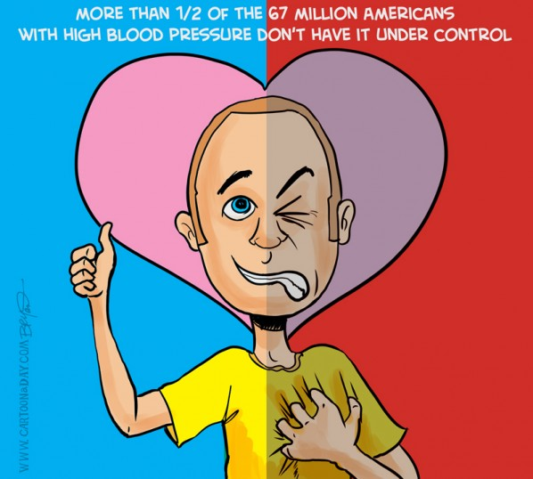
Physical Therapy
Risk Factors for CVA
What puts patient at risk for CVA???
EXTREMELY HIGH BLOOD PRESSURE
SMOKING
Age
Notes:
HIGH BP- could be very dangerous when not controlled
Smoke- when you smoke it hardens your arteries
-stops good blood flow
-chronic smokers are at high risk

Slide 11
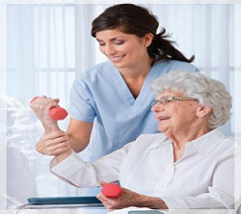
Physical Therapy
Therapeutic Interventions for CVA
Depends of the level of the CVA patient
Example- Joyce Williams
Work on gate balance and standing tolerance
Strengthening exercises
Work on proper gate technique
Documentation
Notes:
She may not ever get back to normal
-Her activity tolerance is not high
-able to stand for short periods of time
-Stregthening exercises- knee extension, leg abduction, pulley extension
GATE TECHNIQUE- Antalgic gate- walking with pain, shuffling gate

Slide 12
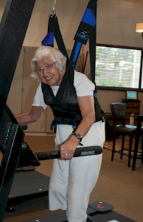
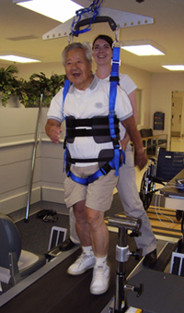
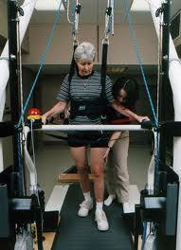
EQUIPMENT IN REHAB FACILITY
Pneu weight
Notes:
Pneu weight- unweighing machine that enables you to take a large amount of weight off of the patient which decreases pressure off of the spine and makes it easier for proper gate to take place without having to hold up the patient

Slide 13
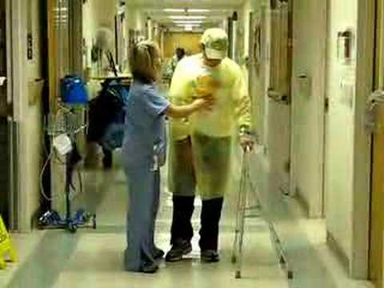
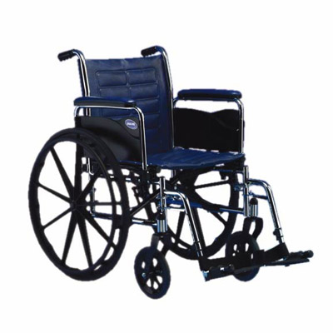
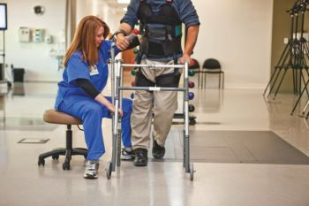
EQUIPMENT IN REHAB FACILITY
Walkers and Wheelchairs
Notes:
Regular walker
Hemi walker
Quad Cane-

Slide 14
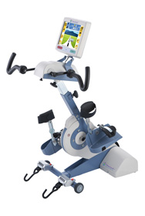
EQUIPMENT IN REHAB FACILITY
OMNI CYCLE

Slide 15
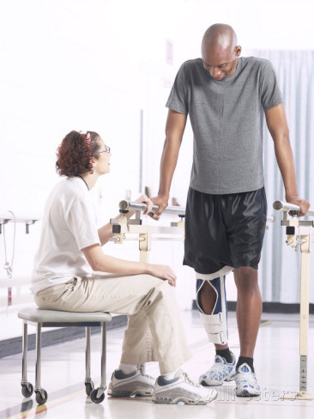
EQUIPMENT IN REHAB FACILITY
Parallel Bars

Slide 16


REIMBURSEMENTS
MEDICARE
MEDICAID
3rd Party insurance company

Slide 17

CHALLENGES
GETTING PATIENTS
COMMUNICATING WITH PATIENTS

Slide 18

CULTURES
Language barriers
Communication

Slide 19
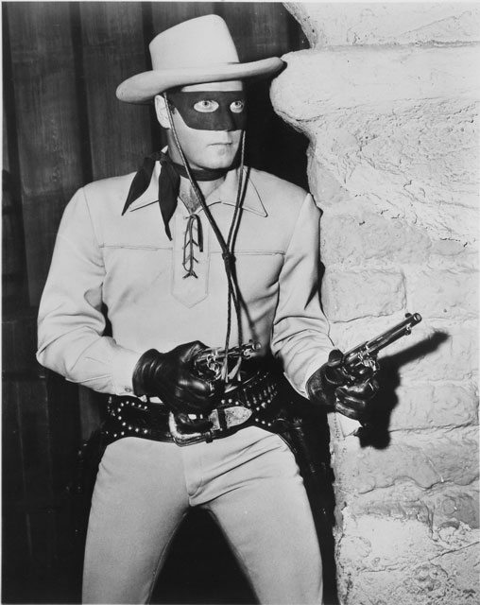
THE LONE RANGER

Slide 20
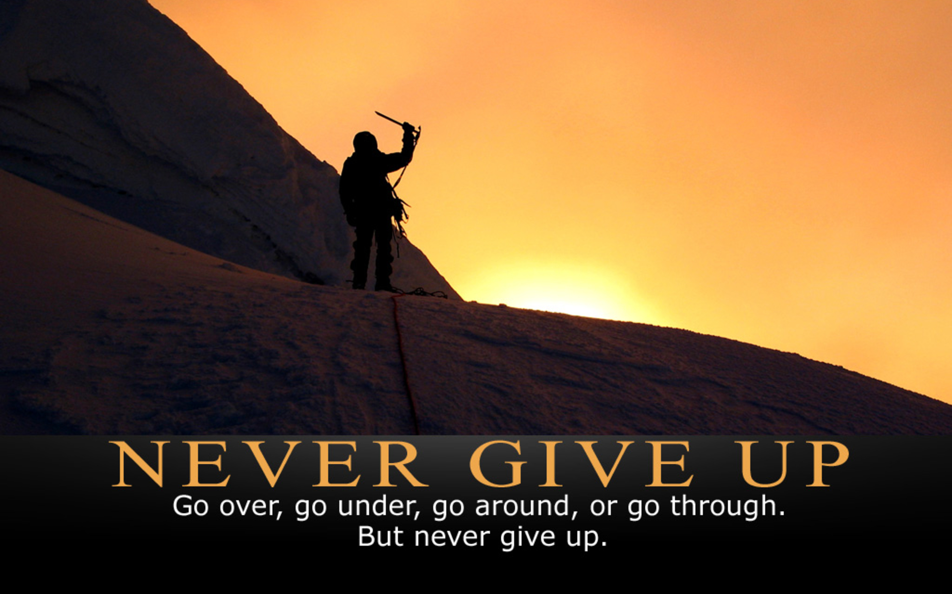
MOTIVATION
I have to become a PT
I want to be part of a team as such
I want to be part of this well oiled machine

Slide 21
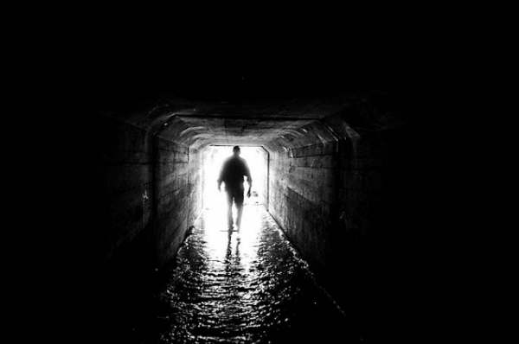
Interest in special populations
Helped me change my view on Physical therapy
Helped me change my view of the geriatric population
Opened my eyes to a whole new light on the field

Slide 22

GOALS
Acquire as much knowledge as possible concerning the field
Get an interview to share my personality and knowledge and ability to succed
Get into PT school
Thrive in excellence while in school
Finish a program and excel in the field

Slide 23

Conclusion
It is bigger than me!!!
“IF AT FIRST YOU DON’T SUCCEED, TRY AND TRY AGAIN!”
DEFINITION OF SUCCESS
GAINED A NEW FOUND PASSION FOR THE FIELD
REACH BACK AND LEND A HELPING HAND TO THOSE COMING UP BEHIND ME

